Slide 1


NSOP 2024
IPR #1
Air Force ROTC Detachment 842
The University of Texas at San Antonio
C/Llanas, C/Parry, & C/Griffin
24 JUL 24

Slide 2


Overview
Staff
Paperwork
Leads/Volunteers
Rooms
Supplies
Summary
Air Force ROTC Detachment 842 • We Build Exceptional Officers • The University of Texas at San Antonio

Slide 3
Staff
C/Llanas
C/Parry
C/Griffin
Air Force ROTC Detachment 842 • We Build Exceptional Officers • The University of Texas at San Antonio

Slide 4
NSOP Date & Time
23 August 2024 (Friday)
Estimated start time: 0800
Volunteers: 0645-0745 (Volunteers briefed on expectations)
Estimated end time: 1600
Volunteers: 1600-1630 (Pack up/Clean up)
Air Force ROTC Detachment 842 • We Build Exceptional Officers • The University of Texas at San Antonio

Slide 5
Paperwork
Emails:
Sports Physical
Pre-NSOP Survey
NSOP UOD
NSOP Requirements (Money/Documents)
Official NSOP Information/Parking
Slack Invitational
Week 1 Overview (PT/ASC/LLAB)
Week 1 Uniform Wear
Nurse Email
Spreadsheets:
Cadet Check-In
Height & Weight
Required Links
Flights A-D & W-Z
Volunteers (Name, Phone Numbers, Availability, & Laptops)
Additional:
GLPs (3) for FCs
Air Force ROTC Detachment 842 • We Build Exceptional Officers • The University of Texas at San Antonio

Slide 6
Leads/Volunteers
About 11 Leads
Height/Weight
Check-in
Runner
NCO Helpers
Tour Guides
Physicals
Hallway Guide
Public Affairs
Volunteers
Between 40-50
Air Force ROTC Detachment 842 • We Build Exceptional Officers • The University of Texas at San Antonio

Slide 7
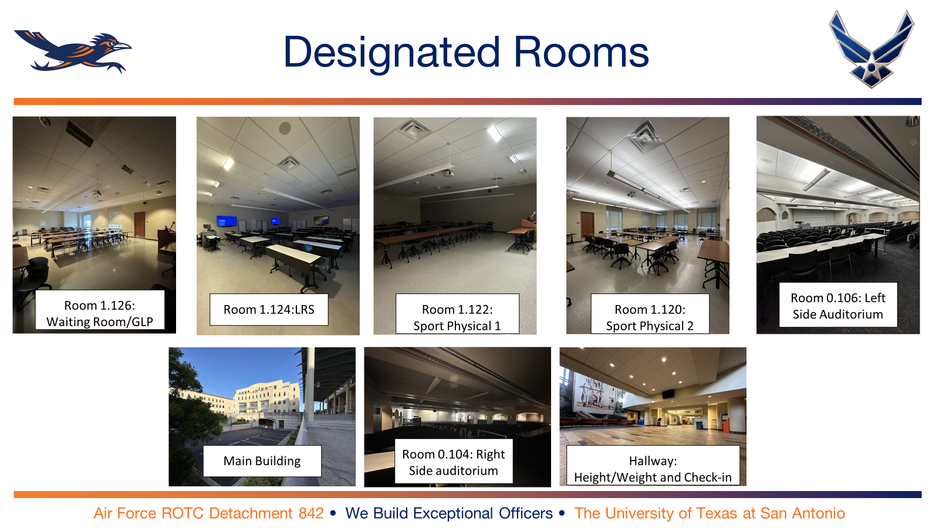
Rooms to Reserve

Slide 8
Supplies
Tables
Chairs
Laptops
Printer
Pens
Paperwork
Direction signs
Tape
Colored Wristbands (Red & Blue)
Height & Weight Scale
Extra copies (physicals)
Food (Pizza)
Waters
Water coolers
Plates/Napkins
Air Force ROTC Detachment 842 • We Build Exceptional Officers • The University of Texas at San Antonio

Slide 9
Summary
Staff
Paperwork
Leads/Volunteers
Rooms
Supplies
Summary
Air Force ROTC Detachment 842 • We Build Exceptional Officers • The University of Texas at San Antonio

Slide 10
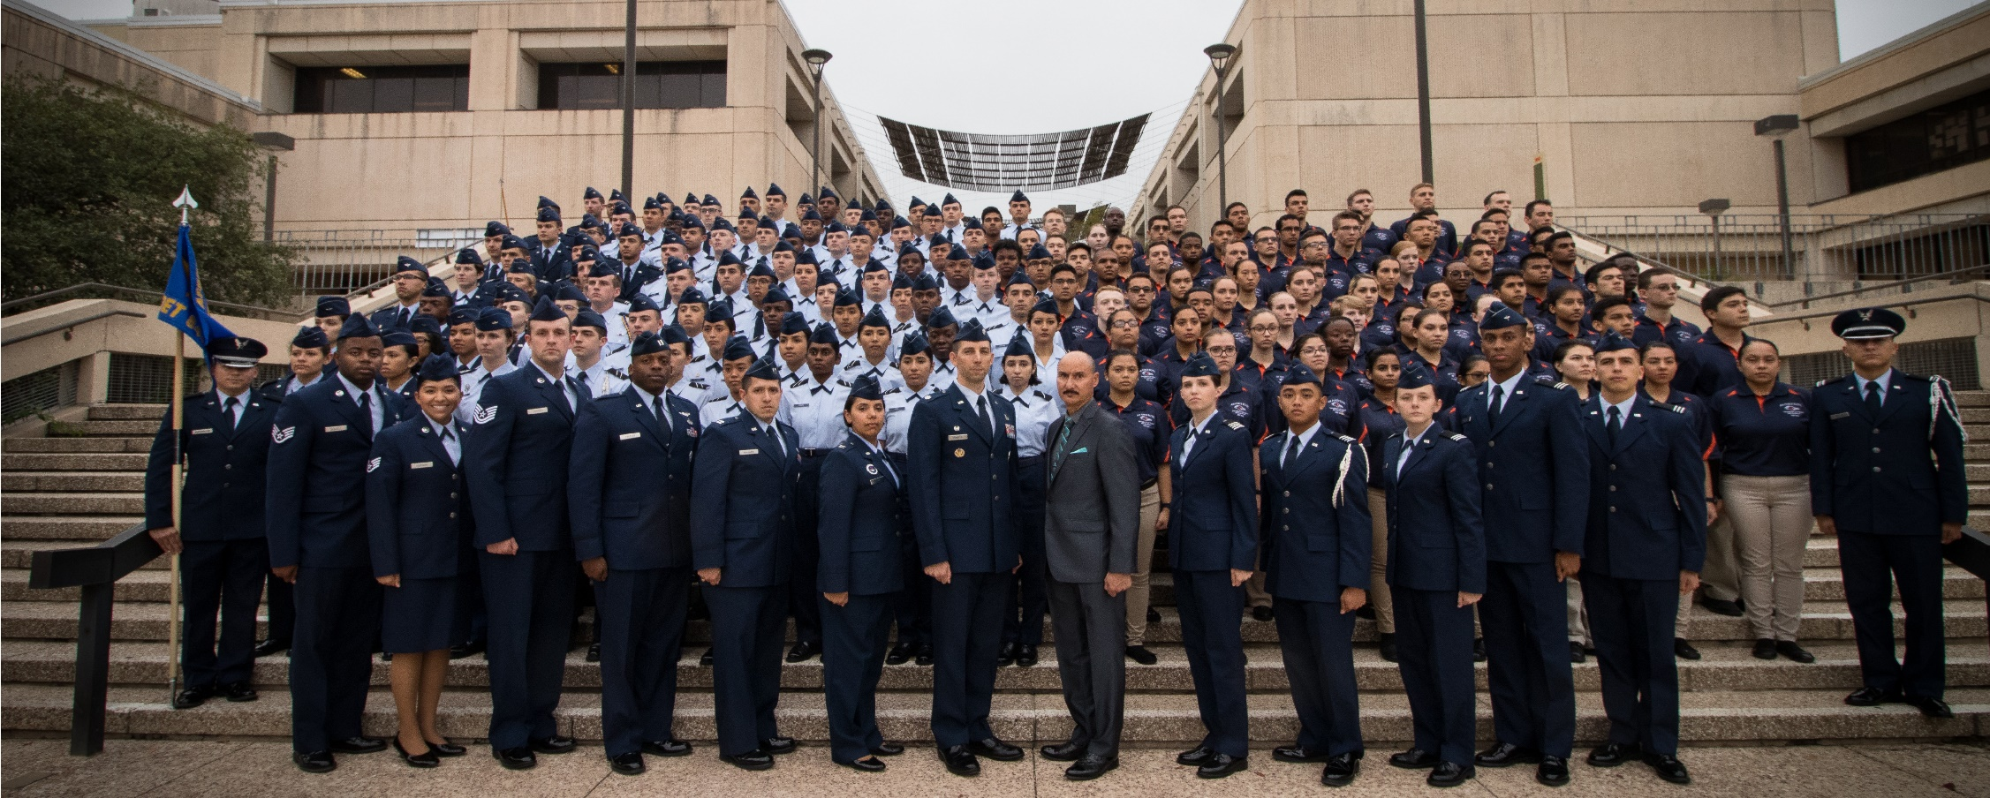
Air Force ROTC Detachment 842
The University of Texas at San Antonio
Det 842 – Best in Blue

